Slide 1

COMET Techniques
Aruna S
Department of
Computer Science and Engineering

Slide 2

COMET TECHNIQUES
Streaming
S. Aruna
Department of Computer Science and Engineering

Slide 3
COMET TECHNIQUES
Streaming
Streaming Comet opens a single persistent connection from the client browser to the server for all Comet events
Events are incrementally handled and interpreted on the client side every time the server sends a new event
HTTP connection is persistent and never closes while streaming
Techniques for accomplishing streaming Comet
Hidden iframe
XMLHttpRequest

Slide 4
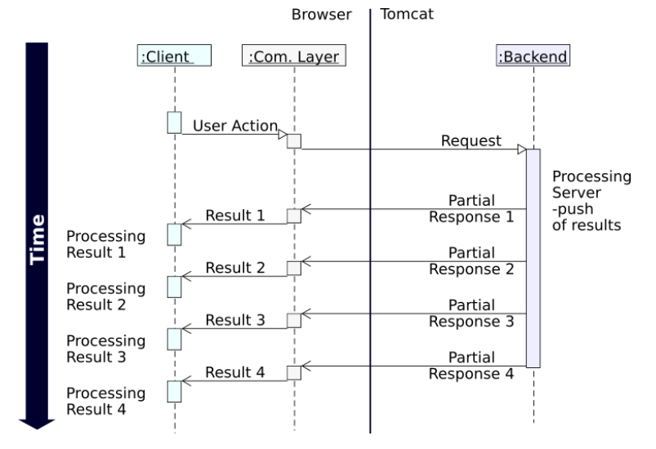
COMET TECHNIQUES
Streaming

Slide 5
COMET TECHNIQUES
Streaming Pros and Cons
PROS
Real Time
Save the most bandwidth usage
Fewer HTTP Request
Easy to implement
Supported by many browsers
CONS
No way to implement error handling

Slide 6
THANK YOU
Aruna S
Department of
Computer Science and Engineering
arunas@pes.edu

